Slide 1
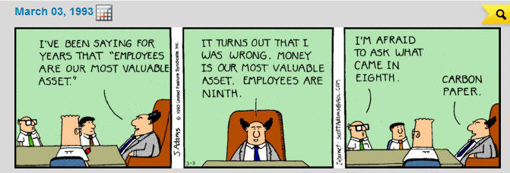
Personnel Management:
Points from DeMarco and Lister's Peopleware, 3rd Edition
Phil Pfeiffer
Fall 2014

Slide 2
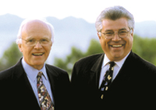
About Peopleware … and these Slides
Peopleware
  Classic book on
  IT people management
    The first in its field
    Brought people management
    issues to the fore
  Authors: Tom DeMarco, Tim Lister
    Efficiency consultants
    Focus on human side of technology management
  3rd edition: 39 chapters on human resource management
These slides distill selected points
  Recommendation: for more, read the book

Slide 3
Observations on IT Problems
Major problems in IT are non-technical
  DeMarco and Lister prefer sociological to political, given difficulty of political processes, tractability of common human relations problems
Managers, however, seem not to manage in this way
  Focus on technical problems
  Prefer to manage IT staff as interchangeable parts
    Fail to encourage people to make some errors – needed because of need for creativity in IT
    Fail to treat people as unique
    Fail to encourage people to learn
      Average IT worker spends 5% of time on planning, investigating new methods, training, reading, estimating, budgeting, scheduling, and allocating personnel
      Average software developer doesn’t own a book on software development and hasn't read one.

Slide 4
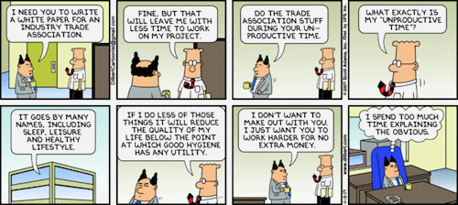
The Spanish Theory of Value
Pressure for unpaid overtime
Analogy – enslavement of the North Am. native peoples in quest for gold, and subsequent devalution of currency
Dangers
  Employees tune out management
  Employees leave for other jobs
  People under pressure don't work better – they just work faster.

Slide 5
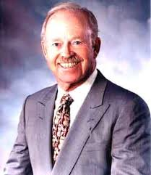
IT and Quality
Differing views
  Managers: just another attribute that can be supplied in different amounts to different clients
  Builders: self-esteem tied strongly to product quality
  Inevitably, a higher standard than the market requires and will pay for
The net result: "flight from excellence"
  Management chides builders for wanting to "tinker forever" with code
  … and blames builders for low quality
Contrary position: Philip Crosby, 1979
  Quality is free (i.e., produces more value than it costs), but only to those who are willing to pay for it
  Positives for emphasis on quality: lower turnover; higher productivity

Slide 6
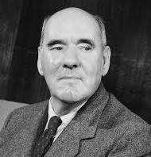
Parkinson's Law
Parkinson's Law – work expands to fill available time
– almost surely doesn't apply to your people, right?
  Their lives are too short to allow much loafing
  They enjoy their work
  They are as eager as you to finish,
  provided quality isn't compromised
  Even on the rare occasions when someone needs to be leaned on, it's much better for the team to do the leaning
  Treating people as Parkinsonians only demeans and demotivates them
Effect of schedule pressure on productivity (study, Univ. New S. Wales)
  Estimates by
    programmer alone: 8.0 (study metric)
    supervisor alone: 6.6
    programmer and supervisor: 7.8
    systems analyst: 9.5
    no estimates at all: 12.0
A frightening observation – Parkinson's for organizations:
  Organizational busy work tends to expand to fill the working day

Slide 7
Seven False Hopes of Project Management
You've missed some trick that could send productivity soaring
Other managers are getting gains of 100% or 200% or more
Technology is moving so swiftly that you're being bypassed
  The business of software development is still rather static
  Most time still goes into requirements and specification, which are low-tech
Changing languages will yield huge gains
  Gains are typically at best 5%
Because of backlogs, productivity must double immediately
  The typical software project is backlogged because there's barely enough benefit to justify building it
Isn't it time you automate away your software development staff?
  Developers' principle work is human communication to organize needs into formal procedures – a task that isn't likely to be automated
Your people will work better if you pressure them

Slide 8
Productivity Factors
There are a million ways to lose a workday, but not even a single way to get one back.
Measuring productivity factors: the coding game
  600+ participants from 92 organizations from 1984 to 1986
  All specific results kept confidential
  Observations
    The best people outperform the worst by 10:1
    The best performers outperform the median by 2.5:1
    Better-than-median performers outperform worse-than-median by 2+:1
Productivity non-factors
  Language: Pascal ≈ C ≈ COBOL ≈ FORTRAN
  Years of experience: less than 6 months not as well; otherwise, a non-factor
  Number of defects: zero-defect workers took slightly less time to complete
  Salary: very weak relationship – better-than-median earned 10-% more
Productivity factors
  Organizations: 10:1 difference across organizations

Slide 9
Environmental Impediments to Productivity
Coding game correlations
Police-mentality planners design workplaces the way they would design prisons: optimized for containment at minimal cost … For most organizations with productivity problems, there is no more fruitful area for improvement than the workplace.
Environmental factor | 1st quartile performers | 4th quartile performers
Amt. dedicated work space | 78 sq. ft | 46 sq. ft.
Space is acceptably quiet | 57% yes | 29% yes
Space is acceptably private | 62% yes | 19% yes
Phone can be silenced | 52% yes | 10% yes
Calls can be diverted | 76% yes | 19% yes
People often create needless interruptions | 38% yes | 76% yes

Slide 10
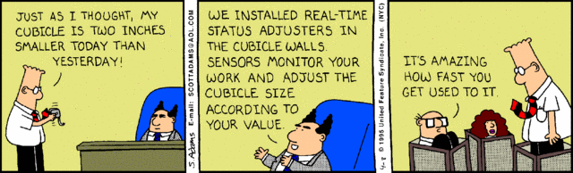
Environmental Issues:
Workspace
DeMarco and Lister consider open-plan seating a "plague"
Excerpt from Data Management magazine
  Cited electrical distribution, computer support, dealer service as key issues
  Nothing about people and employee productivity
1978 IBM study on space allocation – minimum recommendations
  100 sq. ft. dedicated space per worker
  30 sq. ft. work surface per person
  noise protection via enclosed offices or 6' high partitions
Space issues – planning game findings
  16% of participants had 100 sq. ft. or more of office space
  11% worked in enclosed offices or offices with 6'+ high partitions
  More participants in 20-30 sq. ft. group than in 100+ sq. ft. group
  Workers w. acceptably quiet offices were 1/3 more likely to deliver zero-defect work
  66% of zero-defect workers reported OK noise levels
  8% of one-or-more-defect workers reported OK noise levels

Slide 11
Environmental Issues: Interruptions
In most of the office space we encounter today, there is enough noise and interruption to make any serious thinking virtually impossible.
High-momentum tasks (design, writing, development…) require flow
DeMarco and Lister measured flow in workplaces with E-factor
  Definition: (Uninterrupted/ Body-Present) Hours, where
  Uninterrupted hours =
  uninterrupted time - 15 min. per uninterrupted-work-killing interruption
  DeMarco and Lister recorded E-factors at U.S. government agencies of between 0.10 and 0.38

Slide 12
Campaigning for Improved Workspace
Objections
  Employees don't care about private space – and those that do are "just" making a ploy for status
  Cheaper ways of noise abatement, like piped-in music
  Enclosed offices inhibit workplace interaction, vitality
Counter-arguments
  Employees care about work; poor workspaces cost productivity
  Background music inhibits creative thought (Cornell study)
  Small suites are workable and better than open space
Recommendations for effective workspaces
  Based on Alexander, A Timeless Way of Building
  Recommendations
    Let employees tailor workspaces from a kit of possibilities
    Provide windows
    Provide outdoor as well as indoor work space
    Provide public space

Slide 13
People Management: Leadership, Hiring
Leadership styles
  Work extraction leadership: leading from behind, with a gun (Trotsky)
  Sevice leadership: maximize value for employees, with humor and goodwill
Leadership vs. innovation
  While upper management talks a good game, innovation is subversive
    Takes time away from "productive" work
    Unwelcome: requires accommodating change
    Perceived as power grab
  Requires some rebelliousness in employees, mid-level managers
Finding skilled employees
  Ask for portfolios
  Aptitude tests are useful – just not for hiring, since they measure current skills, rather than ability to acquire new skills as demands shift
  Teach people that interrupting work every 15 minutes to (e.g.) text or check Facebook is not flow

Slide 14
People Management: Preserving Human Capital
Healthy companies don't fast-track promotions
  Quick promotions typically used to discourage people from leaving
  Typically puts people into positions they can't handle well
  Symptomatic of top-heavy management
Why people leave
  No investment in employees: e.g., no training, sense of dispensibility
  Turnover engenders turnover: why hire top-quality people or train staff if people are leaving, anyway
  Company moves to another city: no bigger ego trip or cause of misery
    Typical rationale (Townsend, Up the Organization)
      The best people will go with you
      The people in the new location will be better, because your keeping the best people will attract better new hires
      Dubious employees can use move as an excuse to change jobs
    DeMarco and Lister: "purest crap"
      Ignores women in workforce and family issues
      You can do less damage to your organization by lining up the staff in front of a machine gun than you do by moving. And that only accounts for the initial loss.

Slide 15
Team Management
The purpose of a team is not goal attainment but goal alignment.
Signs of a jelled team
  Low turnover
  Strong sense of identity
  Sense of eliteness
  Joint product ownership
  Obvious enjoyment from work
Teams and cliques
  Jelled teams are cliques
  Fear of cliques is common with insecure managers
    Managers are not really part of their teams
    Loyalties to strong teams are stronger than company loyalty

Slide 16
Strategies for Killing Teams
Most organizations don't set out consciously to kill teams. They just act that way.
Defensive management
  Mistrust: not allowing employees to make their own decisions
  Most obvious: prescriptive methodologies and technical interference
  ("My people are too stupid to build systems without them.")
Physical separation, including lack of group space
Fragmentation of time: too many conflicting responsibilities
Quality-reduced development
Phony deadlines
Clique control: taking specific steps to break teams up
Motivational accessories: slogan coffee mugs, plaques, pins, key chains …
  Message: management believes virtues can be instilled with posters rather than hard work and managerial talent
Extended overtime

Slide 17
Strategies for Killing Teams: Big-M Methodologies
Attempts to centralize thinking
Results
  A morass of paperwork
  A paucity of methods
  An absence of responsibility
  A general loss of motivation
Methodologies and malicious compliance
  People doing exactly what methodologies prescribe, in spite of their knowing that the result is useless work
  Basis of an Australian form of strike: "work to rule"
Better ways to achieve convergence of method:
training, tools, peer review

Slide 18
Strategies for Killing Teams: Awards
W. Edwards Deming on awards:
  Remove barriers that rob people in management and in engineering of their right to pride in workmanship. This means [among other things] abolishment of the annual or merit rating and management by objectives.
Demotivators
  Annual salary or merit reviews
  Management by objectives
  Praise of certain workers for extraordinary accomplishment
  Awards, prizes, bonuses tied to performance
  Performance measurement in almost any form
Diagnosis
  Managerial cop-out from harder matters: direct personal motivation, coaching, thoughtful team formation, staff retention, and ongoing review of work procedures
  Also, fosters competition rather than cooperation in teams

Slide 19
Suggestions for Helping Teams to Jell
Make a cult of quality
  Marketplace, product customers, clients, and upper management won't support this
  Quality, however, is a focal point around which teams can bind
Provide lots of satisfying closure
  Organizations need far less reassurance than people
  Closure builds satisfaction and chemistry
Build a sense of eliteness
  Uniqueness helps people be at peace with themselves; peace needed for teams to jell
  Great managers sacrifice productivity for control
Allow and encourage heterogeneity
  An enormous aid – takes on a symbolic importance
Preserve and protect successful teams
Provide strategic but not tactical direction
Make work fun: i.e., make a place for adventure, silliness, and small amounts of constructive disorder

Slide 20
Addressing Risk
One risk that's almost never managed: what happens if we fail?
  It's not reasonable to leave unmanaged the risk for which the consequences are "just too awful to think about".
The risk of false challenges
  Often, setting goals is done to get team members to finish work on the cheap
  The more marginal a project's benefit, the more important it becomes to deliver the project cheaply
  Key characteristics: marginal benefit, with huge, unmanaged schedule risk

Slide 21
Wasting People's Time
The ultimate management sin
How to do this
  Early project overstaffing
    Early understaffing makes managers of projects on tight deadlines look bad by project's end
    Maybe "90%" of projects suffer from this?
  Fragmenting knowledge workers' time over too many tasks
  E(vil)-mail
    Corporate spam
    Unneeded FYIs, including pushing information about activities onto those who don't need it
  Meetings

Slide 22
Wasting People's Time: Meetings
Technology has made meetings worse by making them easier to bear
  Allows people to escape from the pointlessness of the meeting
  Open the laptop, check e-mails, look up meeting-related factoids…
Stand-up meetings
  Cynical view: force laptops to stay closed
  Benefit: shortens meeting, since people won't stand long for standing
Working meetings
  Purpose: come to a decision
  Blessedly focused on closure
Ceremonial meetings
  Run by the clock
  Sometimes useful
Status meetings
  About status – i.e., letting everyone know the boss is the boss
Curing organizational meeting addiction
  Eliminate most ceremonial meetings
  Spend more time in one-on-one conversations
  Encourage open-space networking

Slide 23
Managing Change
People hate change … and that's because people hate change … I want to be sure that you get my point. People really hate change. They really, really do.
- Steve McMenamin
[N]othing is more difficult to handle, more doubtful of success, nor more danagerous to manage, than to put oneself at the head of introducing new orders. For the introducer has all those who benefit from the old orders as enemies, and he has lukewarm defenders in all those who might benefit from the new orders.
- Niccolò Machiavelli
Spectrum of response to change – Jerry Johnson
  Blindly loyal (ask no questions).
  Believers but Questioners
    Skeptics ("show me")
    Passive Observers ("what's in it for me?")
    Opposed (Fear of Change)
    Opposed (Fear of Loss of Power)
  Militantly opposed (Will Undermine and Destroy)
"Only meaningful allies" – Believers but Questioners
  Blindly loyal too unstable to trust

Slide 24
Managing Change
Don't trust rationality as a trump card for effecting change.
  The fundamental response to change is not logical, but emotional.
A better model for change
  Celebrate the old as a way to help change happen
  Expect chaos after change, inevitably
  Help people feel safe about change
    Change will only happen if people feel that failure is OK
Where change tends to originate and organizational learning happens
  Not upper management: too much time often required for financial concerns
  Not lower management: too many constraints, too little awareness of issues, too little power
  That leaves … middle management
    Note that flattening management almost always impacts organizational learning
    The converse, however, requires cooperation between managers, which often doesn't happen, due to relative isolation from one another

Slide 25
… And, Finally, Politics
Aristotelian ideal
  Art of healthy community-making
  Extension of ethics to larger groups
Why community-building matters
  Retention of investment in human capital
  Better productivity through better morale
  Sense of self-worth for the builders – a creation
  Requires time and effort
  Will, like art, require individual strategies

